Slide 1
Windows Communication Foundation
Parameswari Ettiappan
Notes:
WCF – unification of existing distributed communications stack, e.g. ASMX, WSE, Remoting, Enterprise Services.

Slide 2
Agenda
WCF Architecture
Contracts
Bindings
Address
Behaviours
Windows Process Activation Service
Hosting WF from WCF in IIS 7.0
Security

Slide 3

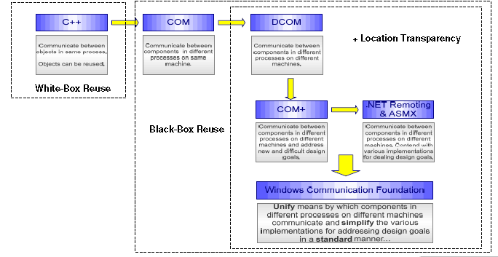

Slide 4
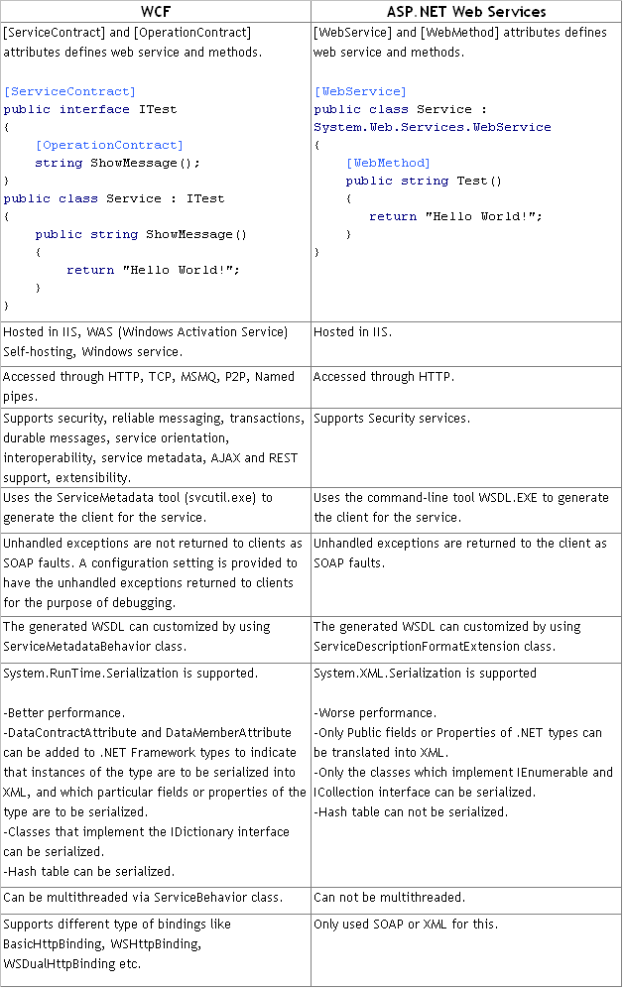
10 Differences Between WCF and ASP.NET Web Services

Slide 5
What is WCF?
Windows Communication Foundation (WCF) is a framework for building service-oriented applications.
Using WCF, you can send data as asynchronous messages from one service endpoint to another.
A service endpoint can be part of a continuously available service hosted by IIS, or it can be a service hosted in an application.
The messages can be as simple as a single character or word sent as XML, or as complex as a stream of binary data.
Notes:
Windows Communication Framework – what the HECK does that mean? WCF, WPF, WF, Microsoft’s merry-go-round of acronyms seems to have experienced exponential growth with the releases of 3.0 and 3.5. Is it all just marketing hype? Fortunately, no!
WCF was first released in 3.0, and lives in its most current form in 3.5. WCF puts a wide swath of .NET service technologies all under the same roof. Windows Communication Framework utilizes declarative and configuration-driven programming to enable you to define multiple endpoints against the same code. In a lot of ways, it is very much a hybrid of legacy ASMX, WSE, Web Service Enhancements and remoting all in one.
Juval Lowy very rightly describes WCF as “plumbing,” and as “an SDK for developing and deploying services on Windows.”

Slide 6
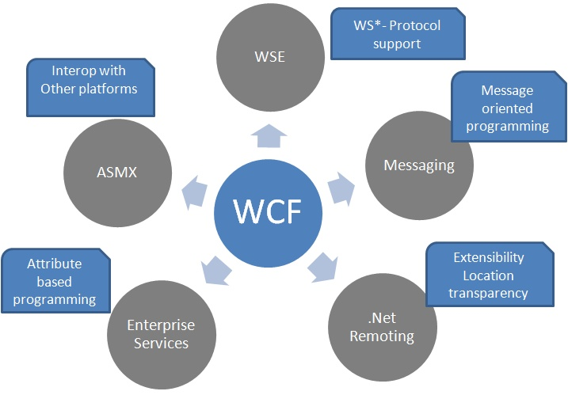

Slide 7
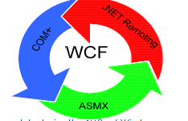
What is WCF?
It is unified programming model introduced in .Net Framework 3.0.
WCF is a combined feature of Web Service, Remoting, MSMQ and COM+.
WCF provides a common platform for all .NET communication.

Slide 8
WCF Scenarios
A secure service to process business transactions.
A service that supplies current data to others, such as a traffic report or other monitoring service.
A chat service that allows two people to communicate or exchange data in real time.
A dashboard application that polls one or more services for data and presents it in a logical presentation.
A Silverlight application to poll a service for the latest data feeds.

Slide 9
Features of WCF
Service Orientation
Interoperability
Multiple Message Patterns
Service Metadata
Data Contracts
Security
Multiple Transports and Encodings
Reliable and Queued Messages
Durable Messages
Transactions
AJAX and REST Support
Extensibility

Slide 10
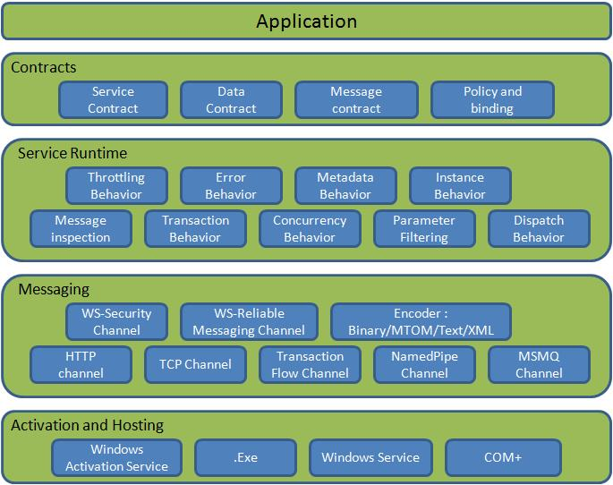
WCF Architecture

Slide 11
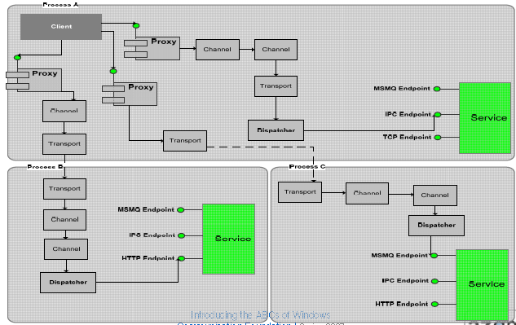

Slide 12
Contracts
Contracts layer are next to that of Application layer.
Developer will directly use this contract to develop the service.

Slide 13
Service Contracts
Describe about the operation that service can provide.
Example, Service provided to know the temperature of the city based on the zip code, this service we call as Service contract.
It will be created using Service and Operational Contract attribute.

Slide 14
Data Contracts
It describes the custom data type which is exposed to the client.
This defines the data types, are passed to and from service.
Data types like int, string are identified by the client because it is already mention in XML schema definition language document but custom created class or datatype cannot be identified by the client e.g. Employee data type.
By using DataContract we can make client aware that we are using Employee data type for returning or passing parameter to the method.

Slide 15
Message Contracts
Default SOAP message format is provided by the WCF runtime for communication between Client and service.
If it is not meeting your requirements then we can create our own message format. This can be achieved by using Message Contract attribute.

Slide 16
Fault Contract
Suppose the service I consumed is not working in the client application.
I want to know the real cause of the problem.
How I can know the error? For this we are having Fault Contract.
Fault Contract provides documented view for error occurred in the service to client.
This helps us to easy identity, what error has occurred.

Slide 17
Policies and Binding
Specify conditions required to communicate with a service e.g security requirement to communicate with service, protocol and encoding used for binding

Slide 18
Service Runtime
It contains the behaviors that occur during runtime of service.
Throttling Behavior- Controls how many messages are processed.
Error Behavior - Specifies what occurs, when internal error occurs on the service.
Metadata Behavior - Tells how and whether metadata is available to outside world.

Slide 19
Service Runtime
Instance Behavior - Specifies how many instance of the service has to be created while running.
Transaction Behavior - Enables the rollback of transacted operations if a failure occurs.
Dispatch Behavior - Controls how a message is processed by the WCF Infrastructure.

Slide 20
Messaging
Messaging layer is composed of channels.
A channel is a component that processes a message in some way, for example, by authenticating a message.
A set of channels is also known as a channel stack.
Channels are the core abstraction for sending message to and receiving message from an Endpoint.

Slide 21
Messaging
Broadly we can categories channels as
Transport Channels Handles sending and receiving message from network. Protocols like HTTP, TCP, name pipes and MSMQ.
Protocol Channels Implements SOAP based protocol by processing and possibly modifying message. E.g. WS-Security and WS-Reliability.

Slide 22
Activation and Hosting
Services can be hosted or executed, so that it will be available to everyone accessing from the client.
WCF service can be hosted by following mechanism
IIS Internet information Service provides number of advantages if a Service uses Http as protocol.
It does not require Host code to activate the service, it automatically activates service code.

Slide 23
Activation and Hosting
Windows Activation Service (WAS) is the new process activation mechanism that ships with IIS 7.0.
In addition to HTTP based communication, WCF can also use WAS to provide message-based activation over other protocols, such as TCP and named pipes.
Self-Hosting WCF service can be self hosted as console application, Win Forms or WPF application with graphical UI.
Windows Service WCF can also be hosted as a Windows Service, so that it is under control of the Service Control Manager (SCM).

Slide 24
WCF Client and Metadata
Get the Proxy class and service end point information
Using SvcUtil.exe we can create proxy class for the service and configuration information for endpoints.
Example type the following sentence in the Visual studio command prompt, this will generate the class file and configuration file which contain information about the endpoints.
svcutil /language:vb /out:ClientCode.vb /config:app.config http://localhost:8090/MyService/SimpleCalculator.svc?wsdl

Slide 25
WCF Client and Metadata
Call operations
Add this class files in the client application. Then create the object for this class and invoke the service operation.
Configuration information we got from the above step has to be added to the client application configuration file.
When the client application calls the first operation, WCF automatically opens the underlying channel.

Slide 26
WCF Client and Metadata
Call operations
This underlying channel is closed, when the object is recycled.
//Creating the proxy on client side MyCalculatorServiceProxy.MyServiceProxy proxy = new MyCalculatorServiceProxy.MyServiceProxy(); Console.WriteLine("Counter: " + proxy.MyMethod());

Slide 27
WCF Client and Metadata
Close the WCF client object.
After using the object created in the above steps, we have to dispose the object. Channel will be closed with the service, when the object is cleared.
MyCalculatorServiceProxy.MyServiceProxy(); Console.WriteLine("Counter: " + proxy.MyMethod());

Slide 28
Metadata
Characteristics of the service are described by the metadata.
This metadata can be exposed to the client to understand the communication with service.
Metadata can be set in the service by enabling the ServiceMetadata node inside the servcieBehaviour node of the service configuration file.
<serviceMetadata httpGetEnabled="True"/>

Slide 29



Clients and Services
Endpoints
Runtime
Behaviours
Address, Binding, Contract
Metadata
Client
Service
A
B
C
ClientChannel
Endpoint
C
B
A
A
B
C
Endpoint
Endpoint
A
B
C
Endpoint
Bv
Bv
ServiceHost
Bv
Bv
Address
Where?
Binding
How?
Contract
What?
Endpoint
Notes:
WCF is about Services that expose operations that are callable by a client application, the service is activated by the client. Service can be ‘One-Way’, Request/Response or Duplex.
Service is exposed through Endpoints, multiple endpoints available for a single service, client endpoint (proxy) generated through service metadata.
Endpoint consists of an Address, a Binding, and a Contract.
Behaviours describe the system semantics, such as concurrency, instancing model, etc. Describe how the service behaves.
At runtime, a service can be hosted either directly, using the ServiceHost class, or in IIS.

Slide 30
End Point
WCF Service is a program that exposes a collection of Endpoints. Each Endpoint is a portal for communicating with the world.
All the WCF communications are take place through end point. End point consists of three components

Slide 31
Address
Basically URL, specifies where this WCF service is hosted .Client will use this url to connect to the service.
e.g
http://localhost:8090/MyService/SimpleCalculator.svc

Slide 32
Binding
Binding will describes how client will communicate with service.
There are different protocols available for the WCF to communicate to the Client.
You can mention the protocol type based on your requirements.

Slide 33
Binding
A binding has several characteristics, including the following:
Transport -Defines the base protocol to be used like HTTP, Named Pipes, TCP, and MSMQ are some type of protocols.
Encoding (Optional) - Three types of encoding are available-Text, Binary, or Message Transmission Optimization Mechanism (MTOM). MTOM is an interoperable message format that allows the effective transmission of attachments or large messages (greater than 64K).

Slide 34
Binding
Protocol(Optional) - Defines information to be used in the binding such as Security, transaction or reliable messaging capability

Slide 35
Binding
Binding | Description
BasicHttpBinding | Basic Web service communication. No security by default
WSHttpBinding | Web services with WS-* support. Supports transactions
WSDualHttpBinding | Web services with duplex contract and transaction support
WSFederationHttpBinding | Web services with federated security. Supports transactions
MsmqIntegrationBinding | Communication directly with MSMQ applications. Supports transactions
NetMsmqBinding | Communication between WCF applications by using queuing. Supports transactions
NetNamedPipeBinding | Communication between WCF applications on same computer. Supports duplex contracts and transactions
NetPeerTcpBinding | Communication between computers across peer-to-peer services. Supports duplex contracts
NetTcpBinding | Communication between WCF applications across computers. Supports duplex contracts and transactions

Slide 36
BasicHttpBinding
It is suitable for communicating with ASP.NET Web services (ASMX)-based services that comfort with WS-Basic Profile conformant Web services.
This binding uses HTTP as the transport and text/XML as the default message encoding.
Security is disabled by default
This binding does not support WS-* functionalities like WS- Addressing, WS-Security, WS-ReliableMessaging
It is fairly weak on interoperability.

Slide 37
WSHttpBinding
Defines a secure, reliable, interoperable binding suitable for non-duplex service contracts.
It offers lot more functionality in the area of interoperability.
It supports WS-* functionality and distributed transactions with reliable and secure sessions using SOAP security.
It uses HTTP and HTTPS transport for communication.
Reliable sessions are disabled by default.

Slide 38
WSDualHttpBinding
This binding is same as that of WSHttpBinding, except it supports duplex service.
Duplex service is a service which uses duplex message pattern, which allows service to communicate with client via callback.
In WSDualHttpBinding reliable sessions are enabled by default.
It also supports communication via SOAP intermediaries.

Slide 39
WSFederationHttpBinding
This binding support federated security.
It helps implementing federation which is the ability to flow and share identities across multiple enterprises or trust domains for authentication and authorization.
It supports WS-Federation protocol.

Slide 40
NetTcpBinding
This binding provides secure and reliable binding environment for .Net to .Net cross machine communication.
By default it creates communication stack using WS-ReliableMessaging protocol for reliability, TCP for message delivery and windows security for message and authentication at run time.
It uses TCP protocol and provides support for security, transaction and reliability.

Slide 41
NetNamedPipeBinding
This binding provides secure and reliable binding environment for on-machine cross process communication.
It uses NamedPipe protocol and provides full support for SOAP security, transaction and reliability.
By default it creates communication stack with WS-ReliableMessaging for reliability, transport security for transfer security, named pipes for message delivery and binary encoding.

Slide 42
NetMsmqBinding
This binding provides secure and reliable queued communication for cross-machine environment.
Queuing is provided by using MSMQ as transport.
It enables for disconnected operations, failure isolation and load leveling

Slide 43
NetPeerTcpBinding
This binding provides secure binding for peer-to-peer environment and network applications.
It uses TCP protocol for communication
It provides full support for SOAP security, transaction and reliability.

Slide 44
Service Contract
[ServiceContract]
public interface IHello
{
[OperationContract]
string Hello(string name);
}
public class HelloService : IHello
{
public string Hello(string name)
{
return “Hello ” + name;
}
}
Notes:
WCF is a declarative opt-in model.
Use .NET interface to describe the contract, and .NET class to implement the contract – this allows better separation of the contract from the behaviour

Slide 45
Service Contract: OneWay
[ServiceContract]
public interface IIncomingMessage
{
[OperationContract(IsOneWay=true)]
void SendMessage(string name);
}
Notes:
Default messaging pattern is Request/Response – for a One-Way ‘fire and forget’ MEP use the above parameter for simple messaging.

Slide 46
Service Contract: Duplex
[ServiceContract(CallbackContract=typeof(IOutgoingMessage))]
public interface IIncomingMessage
{
[OperationContract(IsOneWay=true)]
void SendMessage(string name);
}
public interface IOutgoingMessage
{
[OperationContract(IsOneWay=true)]
void ReceiveMessage(string s);
}
Notes:
Inside the ServiceContract attribute specify the ServiceContract a client would be required to implement to be able to receive messages asynchronously.
This is NOT the same as the asynchronous pattern available today in .NET Web Services using IAsyncResult, which is a client implantation feature – although this is still available.

Slide 47
Service Contract: Faults
[ServiceContract]
public interface IHello
{
[OperationContract]
[FaultContract(typeof(InvalidNameException))]
string Hello(string name);
}
public string Hello(string name)
{
if(name != “Dave”)
{
throw new FaultException<InvalidNameException>(
new InvalidNameException(“Wrong name"));
}
}
Notes:
Defines what fault types the service may propagate and what the client is expected to handle.

Slide 48
Data Contract
[ServiceContract]
public interface IHello
{
[OperationContract]
string Hello(HelloMessage msg);
}
[DataContract]
public class HelloMessage
{
[DataMember(Name=“From”)]
public string from;
[DataMember(Name=“From”, IsRequired=true)]
public string to;
[DataMember]
public string message;
}
Notes:
Defines how an object should be serialized across the wire. So when using built-in types as operation parameters WCF knows how to serialize these, but for custom types WCF needs to be told what to serialize – this also uses an opt-in model.
This is something you didn’t have to do previously with ASMX, you simply marked class members as public, and you could also control how the object was serialized using XmlAttribute or XmlElement – this is no longer possible and everything is serialized as XmlElement.

Slide 49
Message Pattern
Message is the packet of data which contains important information. WCF uses these messages to transfer information from Source to destination.

Slide 50
Message Pattern
Simplex - It is one way communication. Source will send message to target, but target will not respond to the message.
Request/Replay - It is two way communications, when source send message to the target, it will resend response message to the source. But at a time only one can send a message
Duplex - It is two way communication, both source and target can send and receive message simultaneously.

Slide 51
Message Pattern
Most of the time developer will concentrate more on developing the DataContract, Serializing the data, etc.
WCF will automatically take care of message.
On Some critical issue, developer will also require control over the SOAP message format.
In that case WCF provides Message Contract to customize the message as per requirement.

Slide 52
Message Contract
[DataContract]
[MessageContract]
public class HelloMessage
{
[DataMember]
[MessageBody]
public string from;
[DataMember]
[MessageHeader]
public string to;
[DataMember]
[MessageBody]
public string message;
}
Notes:
Determines what goes where in the WCF message and provides a higher degree of granularity over the message.

Slide 53
Bindings
Binding
HTTP
Text
Security
RM
TX
Transport
Encoders
Protocol
TCP
HTTP
Text
WS-*
Binary
MSMQ
Pipes
MTOM
Custom
Custom
Custom
Notes:
Binding is a combination of elements, and simply picking the right combination of Transport, Encoder, and Protocol. This is something that would normally be controlled by a network administrator or somebody looking after deployment and would be controlled by a configuration file.

Slide 54
Standard Bindings
 | Interop | Security | Session | Transactions | Duplex | Streaming
BasicHttpBinding | BP 1.1 | T
WsHttpBinding | WS | T | S | X | X
WsDualHttpBinding | WS | T | S | X | X | X
NetTcpBinding | .NET | T | S | X | X | X | O
NetNamedPipesBinding | .NET | T | S | X | X | X | O
NetMsmqBinding | .NET | T | S | X | X
NetPeerTcpBinding | .NET | T | S |  |  | X
T = Transport Security | S = WS-Security | O = One-Way Only

Slide 55
Interop Bindings
WCF
* Binding
WS-* Protocols
* Binding
WCF
ASMX/WSE3
WS-* Protocols
Http/WS Binding
WCF
WCF
Http/WS Binding
WS-* Protocols
ASMX/WSE3
MSMQ
MSMQ Protocol
MSMQ Binding
WCF
WCF
MSMQ Binding
MSMQ Protocol
MSMQ

Slide 56
Choosing Bindings
Bindings have semantics
Session, Duplex, Transaction Flow, Transacted Read, Queued Delivery, Ordered, Assurances
Asserting Semantic Requirements in Code
[ServiceContract]
[DeliveryRequirements]
Customization
‘Tweak’ existing standard bindings
Create completely new bindings

Slide 57
Binding and Behavior
<endpoint address="http://localhost:8090/MyService/MathService.svc" contract="IMathService" binding="wsHttpBinding"/>
<endpoint address="net.tcp://localhost:8080/MyService/MathService.svc" contract="IMathService" binding="netTcpBinding"/>
One of the client will access SOAP using http and other client will access Binary using TCP

Slide 58
Addresses
http://microsoft.com:80/OrderService/WS
https://microsoft.com:443/OrderService/BP
net.tcp://microsoft.com:808/OrderService/TCP
net.pipe://microsoft.com/OrderService/NP
Scheme | http, https, net.tcp, net.pipe
Host Name | microsoft.com
Port (Optional) * | 80, 443, 808
Base Path | /OrderService/
Endpoint Address | WS, BP, TCP, NP
* - Port Does Not Apply to Named Pipes

Slide 59

Service Hosting Options
ServiceHost allows for hosting anywhere
Console applications
Windows applications
Windows services
IIS provides a scalable host environment
Edit a .svc file and point at your service
Only HTTP transports in IIS 6.0
All transports in IIS 7.0 (Windows Process Activation Service)

Slide 60
Service Hosting Options
IIS hosting
Self hosting
Windows Activation Service
Windows Service

Slide 61
WCF Hosting
Hosting Environment | Supported protocol
Windows console and form application | HTTP,net.tcp,net.pipe,net.msmq
Windows service application (formerly known as NT services) | HTTP,net.tcp,net.pipe,net.msmq
Web server IIS6 | http, wshttp
Web server IIS7 - Windows Process Activation Service (WAS) | HTTP,net.tcp,net.pipe,net.msmq A summary of hosting options and supported features.

Slide 62
WCF Hosting
Feature | Self-Hosting | IIS Hosting | WAS Hosting
Executable Process/ App Domain | Yes | Yes | Yes
Configuration | App.config | Web.config | Web.config
Activation | Manual at startup | Message-based | Message-based
Idle-Time Management | No | Yes | Yes
Health Monitoring | No | Yes | Yes
Process Recycling | No | Yes | Yes
Management Tools | No | Yes | Yes

Slide 63
Service Hosting
Self-host
class HelloHost
{
static void Main (string[] args)
{
ServiceHost host =
new ServiceHost(typeof(HelloService));
host.Open();
// Wait until done accepting connections
Console.ReadLine();
host.Close();
}
}
IIS-host
http://localhost/HelloService/HelloService.svc
<%@ServiceHost language=c# Service=“HelloService" %>

Slide 64
Service Configuration
<?xml version="1.0" encoding="utf-8" ?>
<configuration>
<system.serviceModel>
<services>
<service name=“HelloService”>
<endpoint address=“”
binding=“basicHttpBinding"
contract="IHello" />
</service>
</services>
</system.serviceModel>
</configuration>
Notes:
App.config or web.config. Doesn’t require an address if hosted in IIS, example above, requires an address if hosted in application.

Slide 65
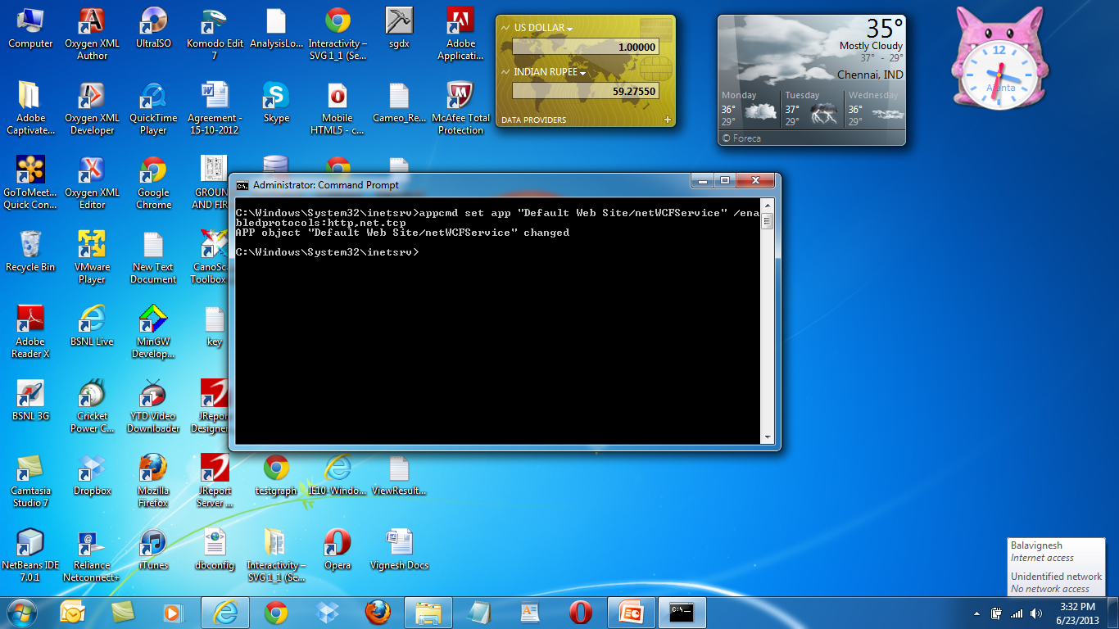
Windows Activation Service

Slide 66
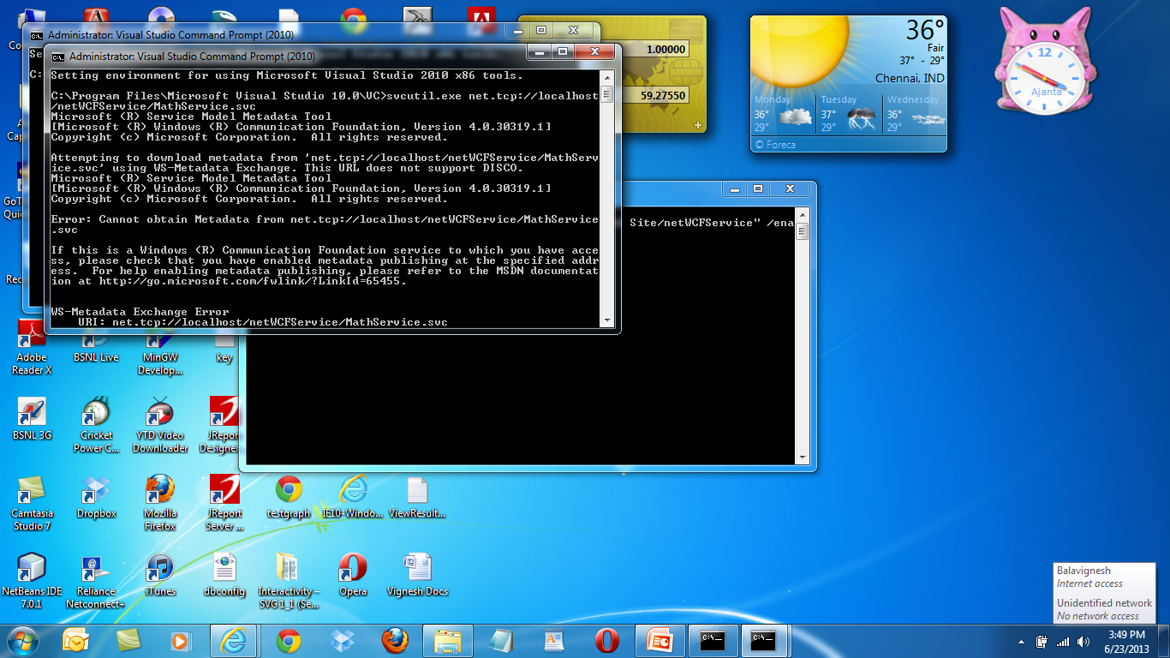

Slide 67
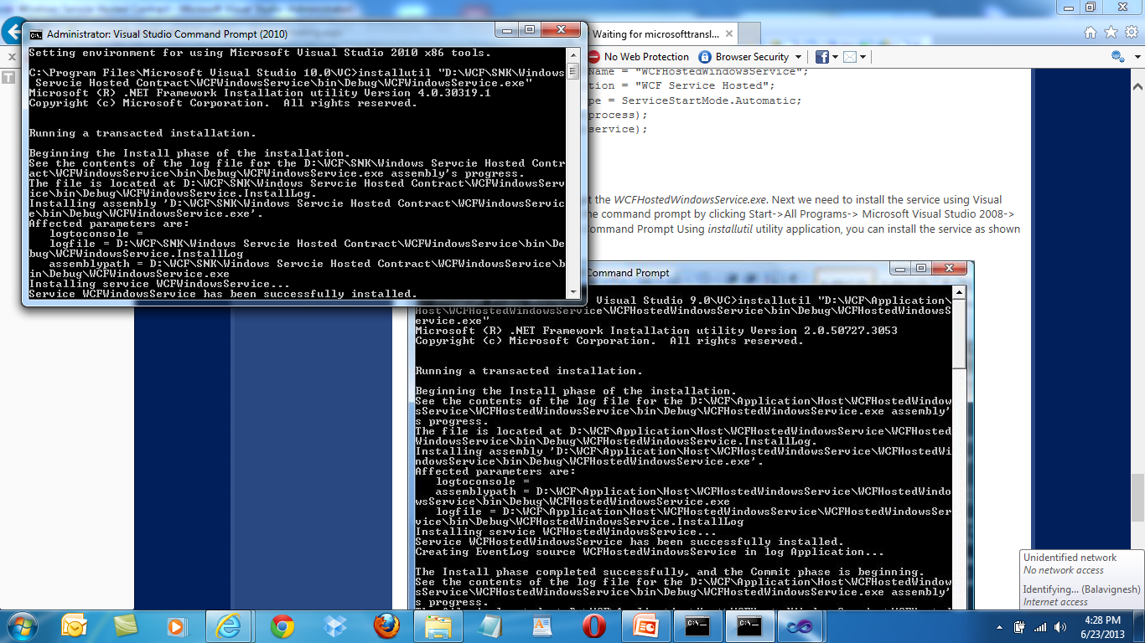
Windows Service

Slide 68
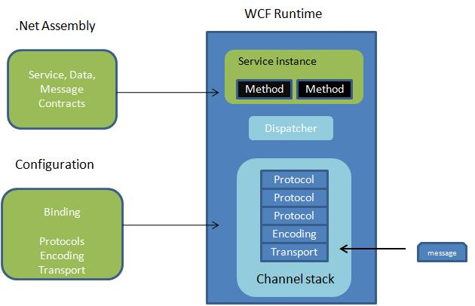
Bindings and Channel Stack

Slide 69
demo
Windows Communication Foundation
Notes:
Hello Service demo

Slide 70
Behaviours
Behaviours cover the system semantics
Service features
Concurrency
Instancing
Transactions
Impersonation
Deployment features
Throttling
Metadata exposure

Slide 71
Instancing

Slide 72
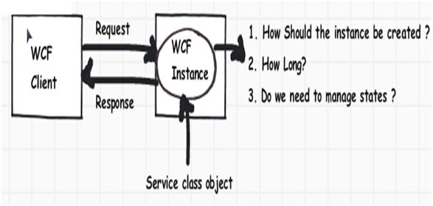

Slide 73
Instancing
Following are different ways by which you can create WCF instances:
Create a new WCF service instance on every WCF client method call.
Only one WCF service instance should be created for every WCF client session.
Only one global WCF service instance should be created for all WCF clients.
To meet the above scenarios, WCF has provided three ways by which you can control WCF service instances:
Per call
Per session
Single instance

Slide 74
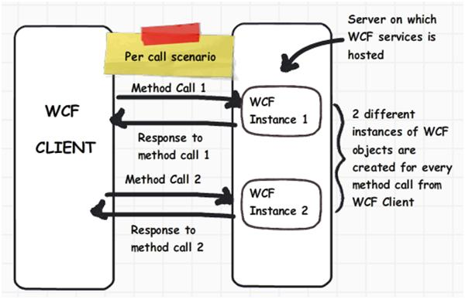
Per call Service

Slide 75
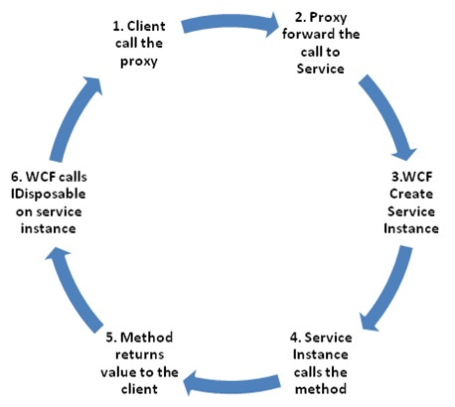
Per Call Service

Slide 76
Per Call Service
[ServiceBehavior(InstanceContextMode=InstanceContextMode.PerCall)]
public class MyService:IMyService {
static int m_Counter = 0;
public int MyMethod()
{
m_Counter++;
return m_Counter; } }

Slide 77
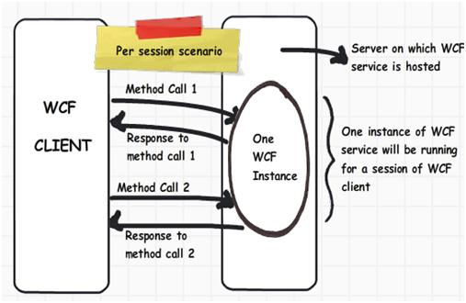

Slide 78
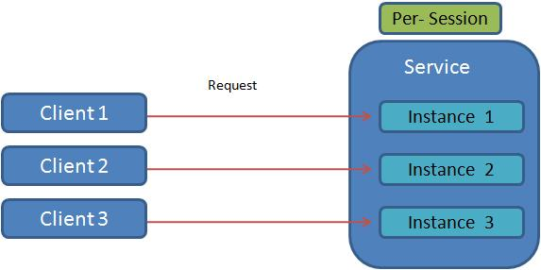
Per Session

Slide 79
Session Timeout
<netTcpBinding>
<binding name="NetTcp_Reliable" receiveTimeout="00:20:00">
<reliableSession ordered="false" inactivityTimeout="00:01:00"
enabled="true" />
</binding>
</netTcpBinding>

Slide 80
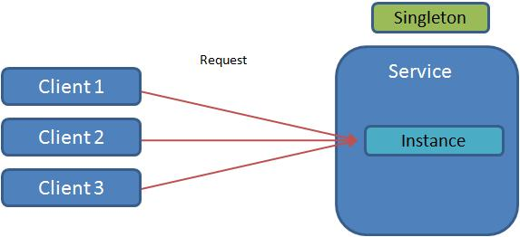
Singleton Service

Slide 81
When To Choose
Per call
You want a stateless services.
Your service holds intensive resources like connection objects and huge memory objects.
Scalability is a prime requirement. You would like to have a scaled out architecture.
Your WCF functions are called in a single threaded model.
Per session
You want to maintain states between WCF calls.
You a scaled up architecture.
Light resource references.
Single
You want share global data through your WCF service.
Scalability is not a concern.

Slide 82
Concurrency
WCF concurrency helps us configure how WCF service instances can serve multiple requests at the same time.

Slide 83
Reasons For Concurrency
Increase throughput: Many times you want to increase the amount of work your WCF service instance does at any moment of time. In other words, you would like to increase the throughput. Throughput means how much work a given thing can do.
By default, a WCF service handles only one request at a given moment of time.

Slide 84
Reasons For Concurrency
Integration with a legacy system: Many times your WCF services interact with legacy systems like VB6, COM, etc.
It’s very much possible that these systems are not multithreaded, in other words they handle only one request at any given time.
So even though your WCF service has concurrent capabilities, you would still like to handle one request at a time.
This is achieved by using throttling in combination with WCF concurrency capabilities.

Slide 85
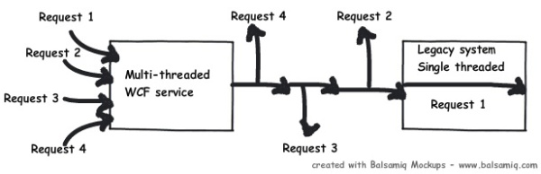
Reasons For Concurrency

Slide 86
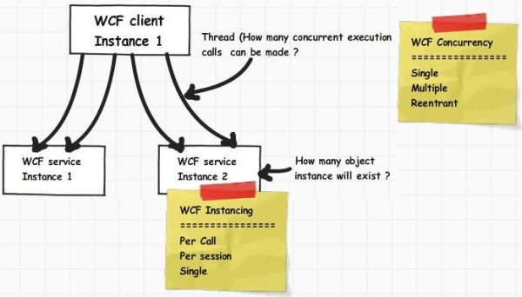
WCF Concurrency and Instantiation

Slide 87
Three Types of Concurrency
Multiple
Reentrant
Single
Notes:
Multiple: The service instance is multi-threaded. No synchronization guarantees are made. Because other threads can change your service object at any time, you must handle synchronization and state consistency at all times.
Reentrant: The service instance is single-threaded and accepts reentrant calls. The reentrant service accepts calls when you call out; it is therefore your responsibility to leave your object state consistent before callouts and you must confirm that operation-local data is valid after callouts. Reentrancy is particularly useful when a service calls another service, which subsequently calls back to the first service. In this case, if the first service is not reentrant, the sequence of calls results in a deadlock. For details, see ConcurrencyMode.
Single: The service instance is single-threaded and does not accept reentrant calls. If the InstanceContextMode property is Single, and additional messages arrive while the instance services a call, these messages must wait until the service is available or until the messages time out.

Slide 88
Concurrency - Single
Single: A single request has access to the WCF service object at a given moment of time.
So only one request will be processed at any given moment of time.
The other requests have to wait until the request processed by the WCF service is completed.
Notes:
Multiple: The service instance is multi-threaded. No synchronization guarantees are made. Because other threads can change your service object at any time, you must handle synchronization and state consistency at all times.
Reentrant: The service instance is single-threaded and accepts reentrant calls. The reentrant service accepts calls when you call out; it is therefore your responsibility to leave your object state consistent before callouts and you must confirm that operation-local data is valid after callouts. Reentrancy is particularly useful when a service calls another service, which subsequently calls back to the first service. In this case, if the first service is not reentrant, the sequence of calls results in a deadlock. For details, see ConcurrencyMode.
Single: The service instance is single-threaded and does not accept reentrant calls. If the InstanceContextMode property is Single, and additional messages arrive while the instance services a call, these messages must wait until the service is available or until the messages time out.

Slide 89
Concurrency - Multiple
Multiple: In this scenario, multiple requests can be handled by the WCF service object at any given moment of time.
In other words, requests are processed at the same time by spawning multiple threads on the WCF server object.
So you have great throughput here but you need to ensure concurrency issues related to WCF server objects.
Notes:
Multiple: The service instance is multi-threaded. No synchronization guarantees are made. Because other threads can change your service object at any time, you must handle synchronization and state consistency at all times.
Reentrant: The service instance is single-threaded and accepts reentrant calls. The reentrant service accepts calls when you call out; it is therefore your responsibility to leave your object state consistent before callouts and you must confirm that operation-local data is valid after callouts. Reentrancy is particularly useful when a service calls another service, which subsequently calls back to the first service. In this case, if the first service is not reentrant, the sequence of calls results in a deadlock. For details, see ConcurrencyMode.
Single: The service instance is single-threaded and does not accept reentrant calls. If the InstanceContextMode property is Single, and additional messages arrive while the instance services a call, these messages must wait until the service is available or until the messages time out.

Slide 90
Concurrency - Reentrant
Reentrant: A single request thread has access to the WCF service object, but the thread can exit the WCF service to call another WCF service or can also call a WCF client through callback and reenter without deadlock.
Notes:
Multiple: The service instance is multi-threaded. No synchronization guarantees are made. Because other threads can change your service object at any time, you must handle synchronization and state consistency at all times.
Reentrant: The service instance is single-threaded and accepts reentrant calls. The reentrant service accepts calls when you call out; it is therefore your responsibility to leave your object state consistent before callouts and you must confirm that operation-local data is valid after callouts. Reentrancy is particularly useful when a service calls another service, which subsequently calls back to the first service. In this case, if the first service is not reentrant, the sequence of calls results in a deadlock. For details, see ConcurrencyMode.
Single: The service instance is single-threaded and does not accept reentrant calls. If the InstanceContextMode property is Single, and additional messages arrive while the instance services a call, these messages must wait until the service is available or until the messages time out.

Slide 91
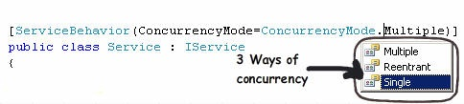
Concurrency
Notes:
Multiple: The service instance is multi-threaded. No synchronization guarantees are made. Because other threads can change your service object at any time, you must handle synchronization and state consistency at all times.
Reentrant: The service instance is single-threaded and accepts reentrant calls. The reentrant service accepts calls when you call out; it is therefore your responsibility to leave your object state consistent before callouts and you must confirm that operation-local data is valid after callouts. Reentrancy is particularly useful when a service calls another service, which subsequently calls back to the first service. In this case, if the first service is not reentrant, the sequence of calls results in a deadlock. For details, see ConcurrencyMode.
Single: The service instance is single-threaded and does not accept reentrant calls. If the InstanceContextMode property is Single, and additional messages arrive while the instance services a call, these messages must wait until the service is available or until the messages time out.

Slide 92
9 combinations of Instancing and Concurrency
the same.
InstanceContext Mode | ConcurrencyMode
 | Single (Default) | Multiple | Reentrant
Single (Single instance for all client) | Single thread for all clients. | Multiple threads for all clients. | Single threads for all clients, locks are released when calls diverted to other WCF services.
PerSession (Multiple instance per client) | Single thread for every client. | Multiple threads for every request. | Single threads for all clients, locks are released when calls diverted to other WCF services.
PerCall (Default) (Multiple instance for every method call) | Single thread for every client | Single thread for every client | Single threads for all clients, locks are released when calls diverted to other WCF services.

Slide 93
demo
Windows Communication Foundation
Notes:
ChatService demo

Slide 94
WAS Activation
Activation and health of worker process is managed by Windows Process Activation Service
Provides “external” monitoring and recycling
Activate over TCP, Named Pipe, MSMQ, or HTTP
Provides high availability, managed process for web service based applications
Notes:
IIS is usually thought of as a Web server, hosting Web pages and applications served up to Web browsers over the HTTP protocol. With IIS 6.0, IIS introduced Application Pools a powerful runtime container that defined the process boundary around Web sites and applications, their process identity, as well as several other recycling, activation and shutdown behaviors. Application Pools are a powerful tool for Web administrators for isolating applications and managing them for health.
IIS7 has generalized the immensely powerful HTTP process activation model that IIS 6.0 introduced with Application Pools, and has made it available for all protocols. This protocol independent service is called the "Windows Process Activation Service". The Windows Communication Framework ships with protocol adapters that can leverage the capabilities of the "Windows Process Activation Service". This can dramatically improve the reliability and resource usage of WCF services.
Hosting WCF Services in the Windows Process Activation Service gives customers the reliability benefits they enjoyed with IIS 6.0, for example health-monitoring, on-demand activation, idle-timeouts etc.

Slide 95
WAS
In IIS 7.0, Windows Process Activation Service (WAS) manages application pool configuration and worker processes instead of WWW Service in IIS 6.0. This enables the same configuration and process model for HTTP and non-HTTP sites.
Additionally, you can run WAS without WWW Service if you do not need HTTP functionality. For example, you can manage an WCF service through a listener, such as NET.TCP, without running the WWW Service if you do not need to listen for HTTP requests in HTTP.sys.

Slide 96
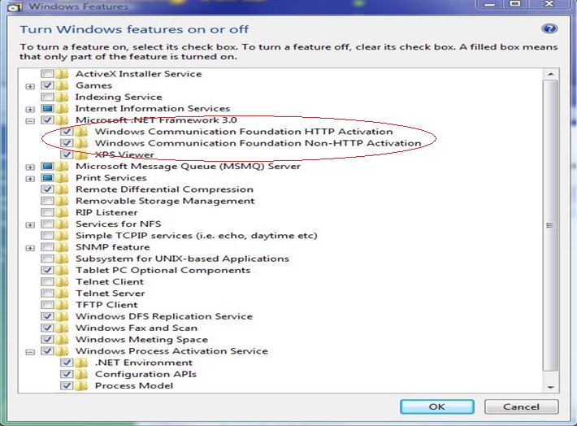
Enabling WAS

Slide 97
Adding net.tcp binding to IIS 7.0
Add net.tcp binding to “Default Web Site”
appcmd.exe set site "Default Web Site" – +bindings.[protocol='net.tcp', bindingInformation='808:*']
Add a new application
appcmd add app /site.name:"Default Web Site" /path:/WasDemo /physicalpath: c:\Inetpub\wwwRoot\WasApplication
Enable protocols for the application
appcmd.exe set app "Default Web Site/WasApplication" /enabledProtocols: http,net.pipe,net.tcp,net.msmq
Notes:
Only works for IIS applications, and NOT virtual directories

Slide 98
demo
Windows Communication Foundation
Notes:
ChatService TCP demo

Slide 99
Throttlling
WCF throttling helps you to put an upper limit on the number of concurrent calls, WCF instances, and concurrent sessions.
WCF provides three ways by which you can define upper limits:
MaxConcurrentCalls,
MaxConcurrentInstances,
MaxConcurrentSessions.

Slide 100
Throttling
<behaviors> <serviceBehaviors> <behavior name="ServiceBehavior"> <serviceMetadata httpGetEnabled="true"/> <serviceDebug includeExceptionDetailInFaults="true "/> <serviceThrottling maxConcurrentCalls="500" maxConcurrentInstances ="100" maxConcurrentSessions ="200"/> </behavior> </serviceBehaviors> </behaviors>

Slide 101
Throttling
ServiceHost host = new ServiceHost(typeof(MyService)); ServiceThrottlingBehavior throttle = host.Description.Behaviors.Find(); if (throttle == null) { throttle = new ServiceThrottlingBehavior(); throttle.MaxConcurrentCalls = 500; throttle.MaxConcurrentSessions = 200; throttle.MaxConcurrentInstances = 100; host.Description.Behaviors.Add(throttle); } host.Open();

Slide 102
Default values for WCF throttling
 | MaxConcurrentSessions | MaxConcurrentCalls | MaxConcurrentInstances
WCF 3.0 / 3.5 | 6 | 26 | 10
WCF 4.0 | 16 * processorcount MaxConcurrentCalls | MaxConcurrentCalls + MaxConcurrentSessions 100 * processorcount | 100 * processorcount

Slide 103
WCF Debugging
Demo

Slide 104
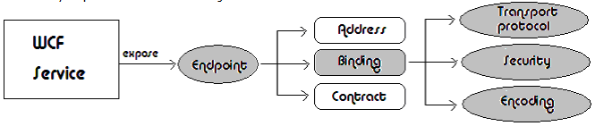
WCF Security

Slide 105
Key Security Features
Auditing
Authentication
Authorization
Confidentiality
Integrity

Slide 106
Scope of WCF Security
Transfer security. Responsible for providing message confidentiality, data integrity, and authentication of communicating parties.
Authorization. Responsible for providing a framework for making authorization decisions.
Auditing. Responsible for logging security-related events to the audit log.

Slide 107
Bindings and Behaviours
Binding | Common scenarios | Default security settings
basicHttpBinding | Legacy Web service protocols | No security
netTcpBinding | Binary TCP communication between machines | Transport security with Windows authentication
wsFederationHttpBinding | Federated security scenarios | Message security with issue token authentication
wsHttpBinding | Leveraging security standards (WS-Security) | Message security with Windows authentication

Slide 108
Transfer Security / Security Mode
Mode | Description
None | No security is provided; all information is passed in clear text.
Transport | Mutual authentication and message protection are provided at the transport level.
Message | Mutual authentication and message protection are provided at the message level.
Both | Mutual authentication and message protection are provided at both the transport and message levels. This is far more than is necessary for most scenarios.
TransportWithMessageCredential | Client authentication is provided at the message level, and message protection and service authentication are provided at the transport level.
TransportCredentialOnly | Mutual authentication is provided at the transport level; no message protection is provided. This option is available only on basicHttpBinding.

Slide 109
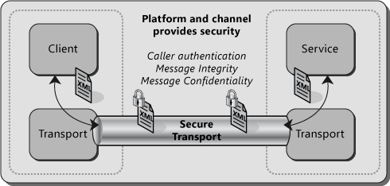
Transport Security

Slide 110
Transport Security
Use transport security for the following scenarios:
You are sending a message directly from your application to a WCF service and the message will not be routed through intermediate systems.
You have both the service and the client in an intranet.

Slide 111
Transport Security
Using transport security has the following advantages:
It provides interoperability, meaning that communicating parties do not need to understand the WS-Security specification.
It may result in better performance.
Hardware accelerators can be used to further improve performance.

Slide 112
Transport Security
Using transport security has the following disadvantages:
Because security is applied on a point-to-point basis, there is no provision for multiple hops or routing through intermediate application nodes.
It supports a limited set of credentials and claims compared to message security.
It is transport-dependent upon the underlying platform, transport mechanism, and security service provider such as NTLM or Kerberos.

Slide 113
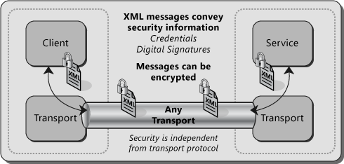
Message Security

Slide 114
Message Security
Use message security for the following scenarios:
You are sending a message to a WCF service, and the message is likely to be forwarded to other WCF services or may be routed through intermediate systems.
Your WCF clients are accessing the WCF service over the Internet, it is possible that other intermediate systems may be used in between, and security is your top consideration.

Slide 115
Message Security
advantages:
It provides end-to-end security. Because message security directly encrypts and signs the message, having intermediaries does not break the security.
It allows partial or selective message encryption and signing, thus improving overall application performance.
Message security is transport-independent and can be used with any transport protocol.
It supports a wide set of credentials and claims, including issue token, which enables federated security.

Slide 116
Message Security
Using message security has following disadvantages:
This option may reduce performance compared to transport security because each individual message is encrypted and signed.
It does not support interoperability with older ASP.NET Web Services (ASMX) clients because it requires both the client and service to support WS-Security specifications.
.

Slide 117
Message Security – Protection Levels
Mode | Description
None | Disables message protection.
Sign | Signs but does not encrypt the message; should be used when data integrity is important.
EncryptAndSign | Signs and encrypts the message.

Slide 118
Message Security
Configuring the Protection Level
[ServiceContract(ProtectionLevel=
ProtectionLevel.Sign]
public interface IService
{ string GetData(int value); }
//Granular Level
[OperationContract(ProtectionLevel=ProtectionLevel.Sign] string GetData(int value);

Slide 119
Service Configuration
<bindings> <basicHttpBinding> <binding name="Binding"> <security mode="Transport"> <transport clientCredentialType="None"/> </security> </binding> </basicHttpBinding> </bindings>

Slide 120
Transport Credential Types
Setting | Description
None | Specifies that the client does not need to present any credential. This translates to an anonymous client.
Basic | Specifies basic authentication for the client. For additional information, see RFC2617—HTTP Authentication: Basic and Digest Authentication.
Digest | Specifies digest authentication for the client. For additional information, see RFC2617—HTTP Authentication: Basic and Digest Authentication.
Ntlm | Specifies NT LAN Manager (NTLM) authentication. This is used when you cannot use Kerberos authentication for some reason. You can also disable its use as a fallback by setting the AllowNtlm property to false, which causes WCF to make a best-effort to throw an exception if NTLM is used. Note that setting this property to false may not prevent NTLM credentials from being sent over the wire.
Windows | Specifies Windows authentication. To specify only the Kerberos protocol on a Windows domain, set the AllowNtlm property to false (the default is true).
Certificate | Performs client authentication using an X.509 certificate.
Password | User must supply a user name and password. Validate the user name/password pair using Windows authentication or another custom solution.

Slide 121
Message Client Credential Types
Setting | Description
None | Specifies that the client does not need to present a credential. This translates to an anonymous client.
Windows | Allows SOAP message exchanges to occur under the security context established with a Windows credential.
Username | Allows the service to require that the client be authenticated with a user name credential. Note that WCF does not allow any cryptographic operations with user names, such as generating a signature or encrypting data. WCF ensures that the transport is secured when using user name credentials.
Certificate | Allows the service to require that the client be authenticated using an X.509 certificate.
Issued Token | A custom token type configured according to a security policy. The default token type is Security Assertions Markup Language (SAML). The token is issued by a secure token service. For more information, see Federation and Issued Tokens.

Slide 122
Enabling SSL
<services> <service name="CustomerService.CustomerService" behaviorConfiguration="MyServiceBehavior"> <endpoint address="" binding="basicHttpBinding" bindingConfiguration="TransportSecurity" contract="CustomerService.ICustomerService" /> <endpoint address="mex" binding="mexHttpsBinding" contract="IMetadataExchange" /> </service> </services>

Slide 123
Enabling SSL
[ServiceBehavior]
public class CustomerService : ICustomerService { private IEnumerable<Customer> LoadCustomers() { //... } public IEnumerable<Customer> GetCustomers() { var customers = new List<Customer>(); customers.AddRange(LoadCustomers()); return customers; } }

Slide 124
Enabling SSL
<behaviors> <serviceBehaviors> <behavior name="MyServiceBehavior"> <serviceMetadata httpsGetEnabled="true" httpsGetUrl="" /> <serviceDebug includeExceptionDetailInFaults="false"/> </behavior> </serviceBehaviors> </behaviors>

Slide 125
Enabling SSL
<bindings> <basicHttpBinding> <binding name="TransportSecurity"> <security mode="Transport"> <transport clientCredentialType="None" /> </security> </binding> </basicHttpBinding> </bindings>

Slide 126
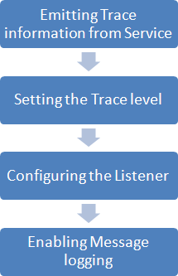
Essenial Steps in tracing

Slide 127
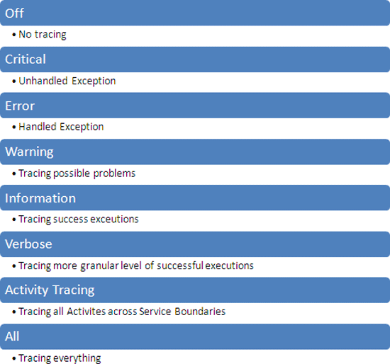
Setting Trace Level

Slide 128
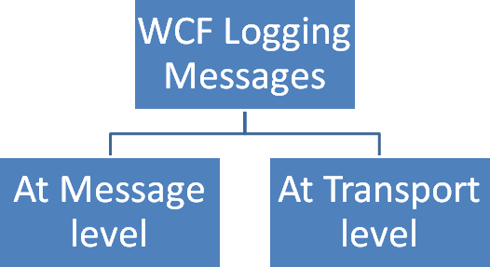
Configuring Tracing

Slide 129
Generate Certificate
makecert.exe from the “C:\Program Files\Microsoft Visual Studio 8\Common7\Tools\Bin” folder.
makecert.exe -sr CurrentUser -ss My -a sha1 -n CN=WCfServer -sky exchange -pe
makecert.exe -sr CurrentUser -ss My -a sha1 -n CN=WcfClient -sky exchange -pe

Slide 130
Generate Certificate
Attribute | Explanation
-sr | Specifies the Registry location of the certificate store. The SubjectCertStoreLocation argument must be either of the following: currentUser: Specifies the registry location HKEY_CURRENT_USER. localMachine: Specifies the registry location HKEY_LOCAL_MACHINE.
-ss | Specifies the name of the certificate store where the generated certificate is saved.
-a | Specifies the algorithm. Can be either MD5 or SHA1.
-n | Specifies a name for the certificate. This name must conform to the X.500 standard. The simplest method is to use the "CN=MyName" format. If the /n switch is not specified, the default name of the certificate is "Joe's Software Emporium".
-sky | Specifies the key type. Can be either exchange or signature.
-pe | This makes the key exportable.

Slide 131
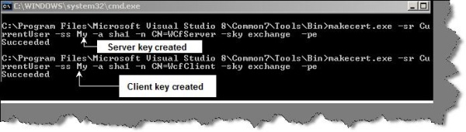

Slide 132
Run MMC to view cerificates

Slide 133
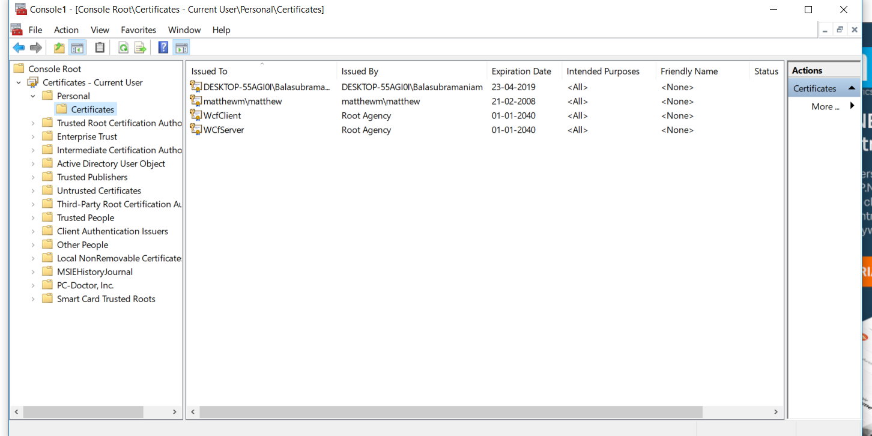

Slide 134
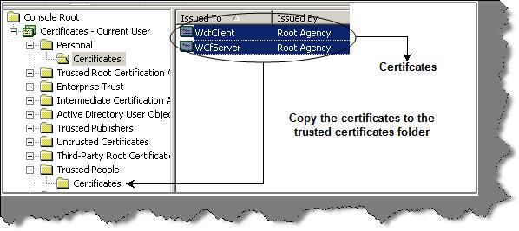

Slide 135
Specify the certification path and mode in the WCF service web.config file

Slide 136
<serviceCredentials> <clientCertificate> <authentication certificateValidationMode="PeerTrust"/> </clientCertificate> <serviceCertificate findValue="WCfServer" storeLocation="CurrentUser" storeName="My" x509FindType="FindBySubjectName" /> </serviceCredentials>

Slide 137
Throttling
ServiceHost host = new ServiceHost(typeof(MyService));
ServiceThrottlingBehavior throttle
= host.Description.Behaviors.Find();
if (throttle == null)
{
throttle = new ServiceThrottlingBehavior();
throttle.MaxConcurrentCalls = 500;
throttle.MaxConcurrentSessions = 200;
throttle.MaxConcurrentInstances = 100;
host.Description.Behaviors.Add(throttle);
}
host.Open();

